Slide 1

OZONE : A TOXIC SAVIOR OF LIFE
AN INSIGHT OF THE ACTUAL PHENOMENON

Slide 2

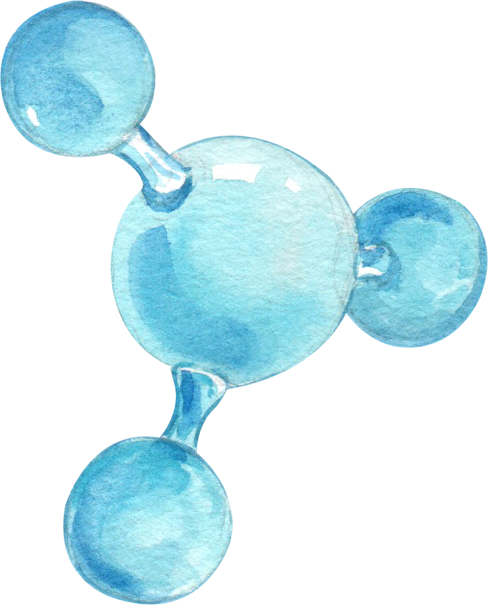

WHAT IS OZONE ?
Ozone is a pale blue-colored gas, with a distinctively pungent smell. Ozone - O₃ (trioxygen allotrope) is an inorganic molecule that is much less stable than O₂ (dioxygen allotrope) of O (Oxygen, 21% of atmosphere).
O₃ breaks down in the lower atmosphere as O₂.

Slide 3
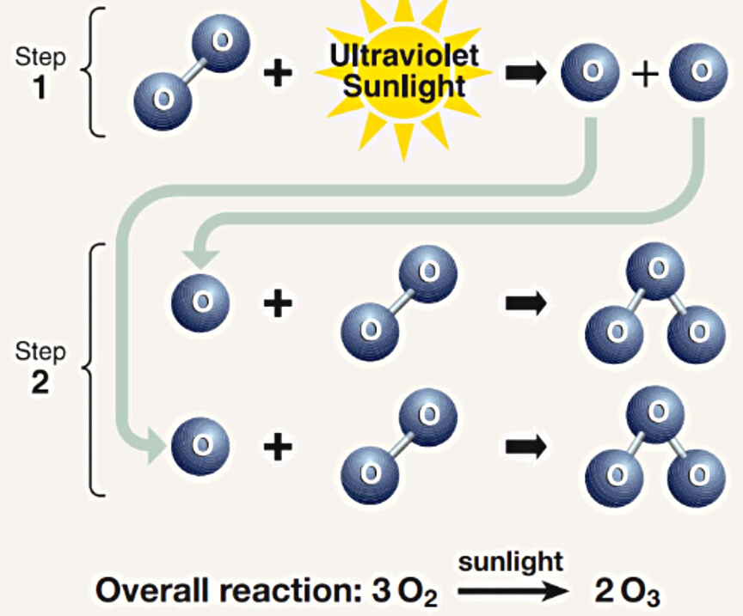
NATURAL CREATION OF OZONE
The largest Production occurs in the tropical stratosphere
Stratospheric Ozone Production
In the presence of solar ultraviolet radiations (sunlight), in steps, with oxygen (O₂, 21% of atmosphere), chemical reactions take place to form ozone molecule, O ₃

Slide 4





Why OZONE LAYER is Important?
Fauna & Human
Marine Ecosystems
Bio-geochemical Cycles
Flora
Materials
Control UVB-entry into earth atmosphere; laboratory & epidemiologist found that:-
  UVB causes Non-Melanoma Skin Cancer.
  Promotes Malignant Melanoma Development.
  It is linked to the development of cataracts (a clouding of the eye's lens).
Plants have abilities to adapt to high UVB levels, still, they're directly affected ---
  Indirect UVB-induced changes in plant form, nutrient distribution, timing of developmental phases, and secondary metabolism.
  Effects on plant's competitive balance, herbivory, plant diseases & biogeochemical changes.
Phytoplankton's (foundation of aquatic food webs) productivity is limited to the euphotic zone, and sunlight having UVB Radiation affects their orientation & motility, causing a threat to marine life.
UVB-Radiation causes damage to the early developmental stages of many marine animals, e.g., reduced reproductive capacity, and impaired larval development.
UVB affects terrestrial & aquatic Biogeochemical Cycles, altering both sources & sinks of Greenhouse & chemically important trace gases (e.g., CO2, CO, COS, O ₃, etc.)
These potential changes contributing to biosphere-atmosphere feedbacks mitigate or amplify the atmospheric concentrations of these gases.
Synthetic Polymers, natural bio-polymers, and commercially sold materials are highly damaged, and their quality & longevity are affected by UVB Radiation.

Slide 5



WHY IS Ground-level OZONE
LIFE-THREATENING
TROPOSPHERIC OZONE EXPOSURE
Depending on the level of 'Tropospheric Ozone Exposure' is detrimental in several ways :
  Hinders vigorous and deep breathing; pain while breathing deeply
  Inflammation & irritation of the tissue linings of human airways
  Lungs become more susceptible to infection, aggravating lung diseases like euphotic zone asthma, emphysema & chronic bronchitis
  Increases frequency of asthma attacks Ozone causes airway muscles to constrict, trapping air in the alveoli- leading to wheezing & shortness of breath

Slide 6



HUMAN-ACTIONS BEHIND OZONE-LAYER CHANGES
ANTHROPOGENIC OZONE-LAYER CHANGES
Human Civilization’s Growth has always prioritized comfort over environmental balance: this self-centered attitude can threaten future generations and the survival of other species.
Aerosols
5%
Different Industrial Emissions, household use of refrigerators producing CFCs, and automobile engines generating harmful greenhouse gases (CFCs & HCFCs) that form Chlorine & Bromine free radicals that are mainly responsible for breaking down, thus destroying the ozone layer.
Foam products
14.3%
Solvent Cleaning products
36.1%
O₃ to O₂
Refrigeration & AC
29.6%
Other products including Halons
12%

Slide 7
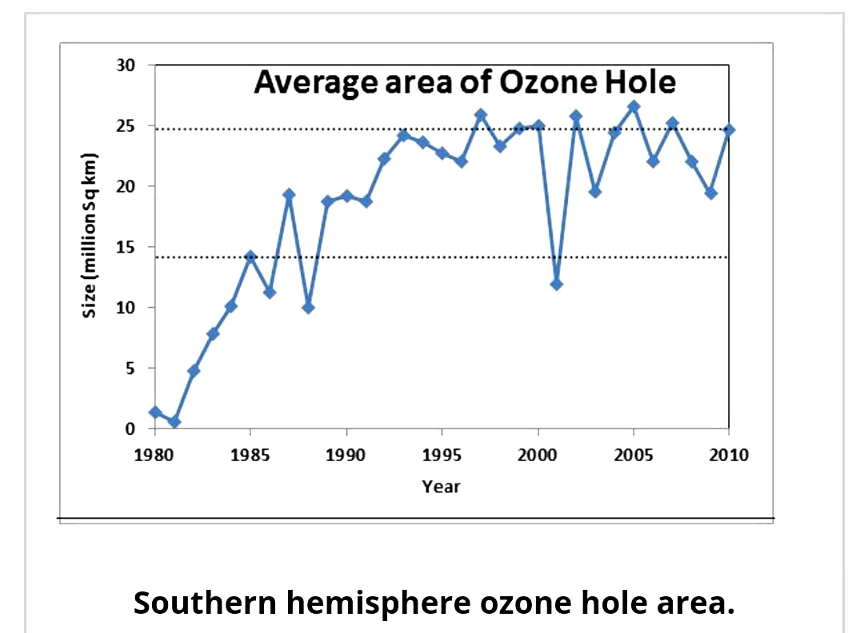
GRAPH
Extreme use of CFCs and petrol (producing CO2) destroys the ozone layer.
From 1979~1980 through to the early 1990s, stratospheric ozone concentrations fell to the concerning ozone-hole level of 100 DU, which continued at approximately around 100 DU (or below) for several following decades...
DU(Dobson Units): Measurement unit for ozone-layer thickness in an air column from ground to atmosphere-top
OZONE-HOLE :
Area having less than 220 DU of ozone (concentration) in the overhead column (i.e., between the ground and space)
The graph compares the size of the Southern Hemisphere ozone hole' over 20 years. Period time, from 1980 – to 2010; where each year, in spring, the ozone hole turns the largest

Slide 8
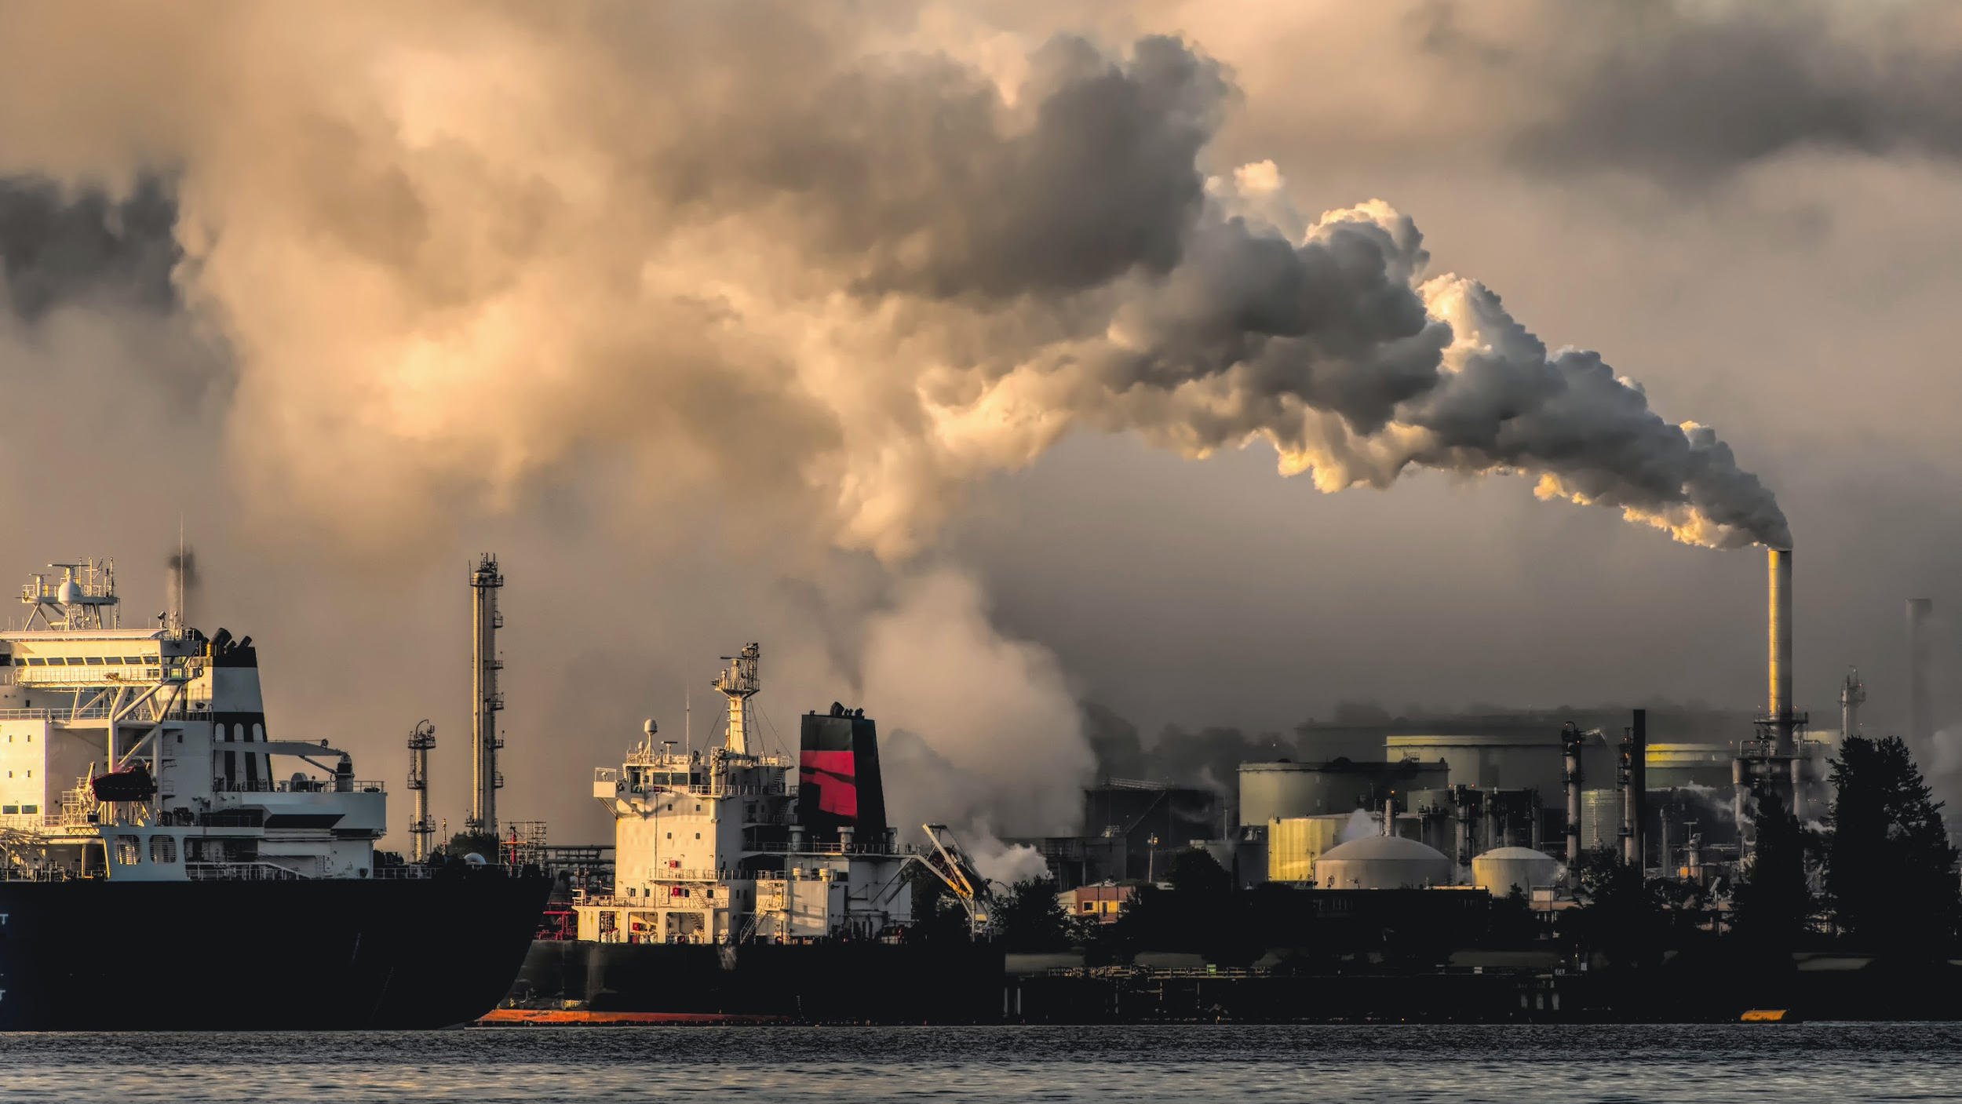
INDUSTRIAL CAUSES BEHIND OZONE-LAYER DEPLETION
A MAJOR ANTHROPOGENIC CAUSE OF OZONE - LAYER DEPLETION
The main causes of ozone depletion (the ozone hole) are manufactured synthetic chemicals, specially manufactured halocarbon refrigerants, AC- equipment, fire-extinguishers, aerosol propellants, solvents & foam-blowing agents (chlorofluorocarbons (CFCs, HCFCs, halons)), known as ozone-depleting substances (ODS).
These different industrial emissions produce CFCs, harmful greenhouse gases (CFCs & HCFCs) that form Chlorine & Bromine free radicals that are mainly responsible for breaking down O₃ to O₂, thus destroying the ozone layer.

Slide 9
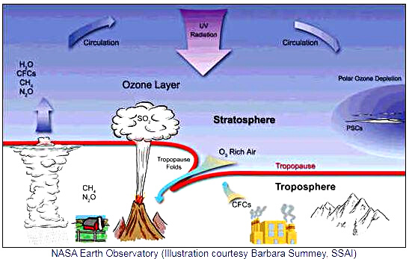
O₃ O₂
STRATOSPHERIC OZONE - LAYER DEPLETION
Human activities cause the emission of halogen source gases that contain chlorine and bromine atoms. These emissions into the atmosphere ultimately lead to stratospheric ozone depletion. The source gases that contain only carbon, chlorine, and fluorine are called “chlorofluorocarbons,” usually abbreviated as CFCs.
Once into the stratosphere, through photo-dissociation, catalytic breakdown of ozone ( O₃ to O₂ ) occurs in cycles...

Slide 10

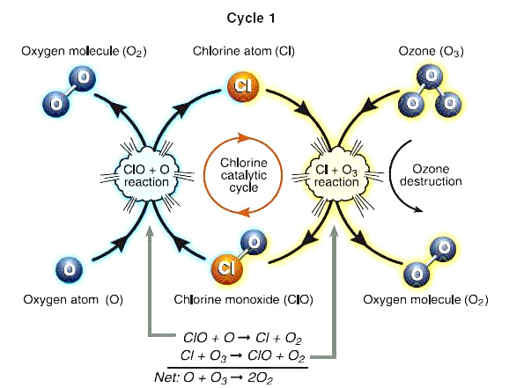
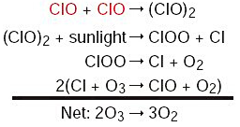
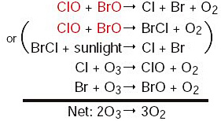
Cycles of Ozone-Layer Depletion
Cycle - 2
Cycle - 1
Cycle - 3

Slide 11
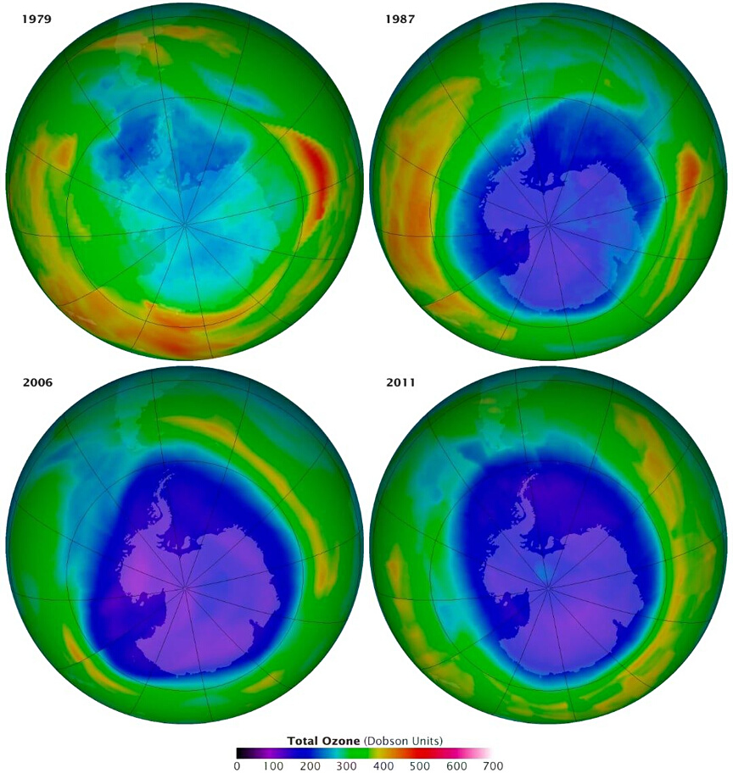
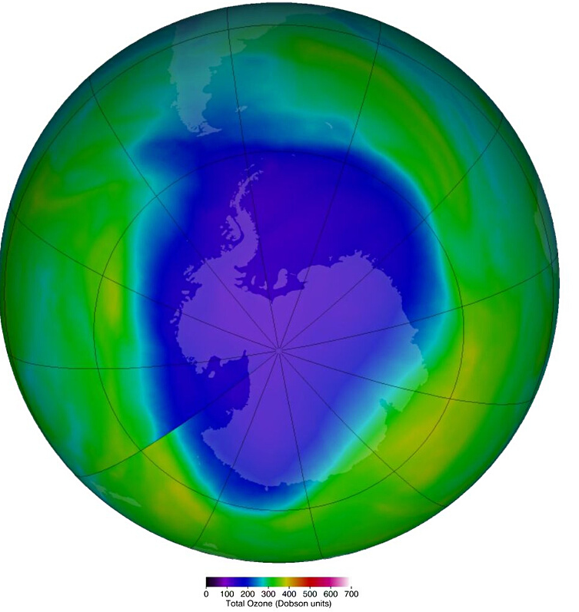
THE OZONE-HOLE
A MOST RECENT DATA
1979
1987
3 November 2022
False-color view of total ozone over the Antarctic pole. The purple and blue colors are where there is the least ozone, and the yellows and reds are where there is more ozone
2006
2011

Slide 12
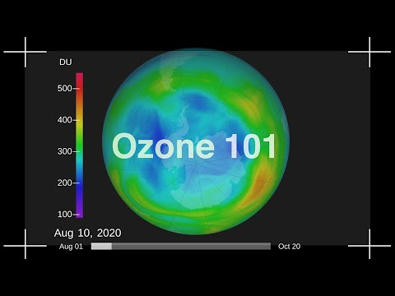
OZONE-HOLE CHANGING

Slide 13
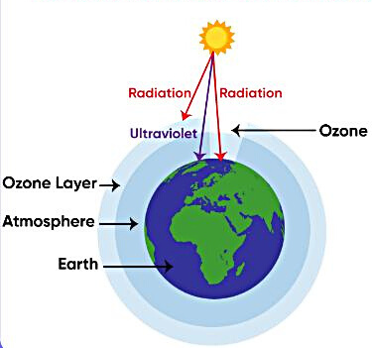
OZONE - HOLE RESULTS IN TROPOSPHERIC UVB - EXPOSURE
OZONE-HOLE EFFECTS
Hole
Ozone Holes allow UVB Radiation into the atmosphere, on the Earth’s surface
Ozone protects us from destructive solar radiation when it’s high above Earth in the stratosphere. Closer to the ground, though, it has other lasting impacts. Ozone at the surface was estimated to cause 365,000 deaths globally in 2019 by damaging the lungs of vulnerable people, such as young children and those with asthma. Similarly, it damages the breathing systems of plants – their ability to photosynthesize – reducing plant growth and crop yields. And at the top of the troposphere, it’s a potent greenhouse gas, increasing global temperatures.

Slide 14
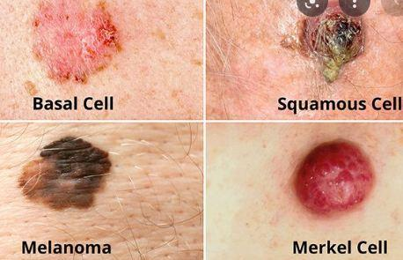
STRATOSPHERIC OZONE DECRES & TROPOSPHERIC OZONE INCREASE
THREATS OF OZONE-IMBALANCE
  Human-Health: positive - increases vitamin D production
negative - sunburn, skin cancer, cataracts
  Basal & Squamous Cell Carcinomas: cause pyridine molecules to form dimers, resulting in transcription errors while DNA replication
  Malignant Melanoma: 19% increase (men) & 16% increase (women) in melanomas
  Cortical Cataracts
  Tropospheric ozone can be fatal due to its highly oxidizing properties for people with asthma and breathing difficulties
  Animals: Epidermal damage of whales in the Gulf of California associated with acute & severe sunburn has been found
  Crops: Plant growth patterns are disturbed & cyanobacteria are sensitive to UVB-Radiation
Carcinomas
Melanoma

Slide 15



BALANCED SUSTENANCE OF HUMAN & OTHER SPECIES
COMPORT COMPLYING WITH OZONE-PROTECTION
  Avoiding ozone-depleting products
  Avoid usage of ozone-threatening gases like CFCs and ODS
  Minimizing car-usage, focus on bicycling or walking
  Avoid using corrosive and non-eco friendly chemical-made cleaning products; replace with vinegar or bicarbonates
  Buy local products: To get fresh product and prevent N₂O-emissions production is carrying-vehicles
  Maintain ACs: Their malfunction allow CFCs to escape to the atmosphere

Slide 16
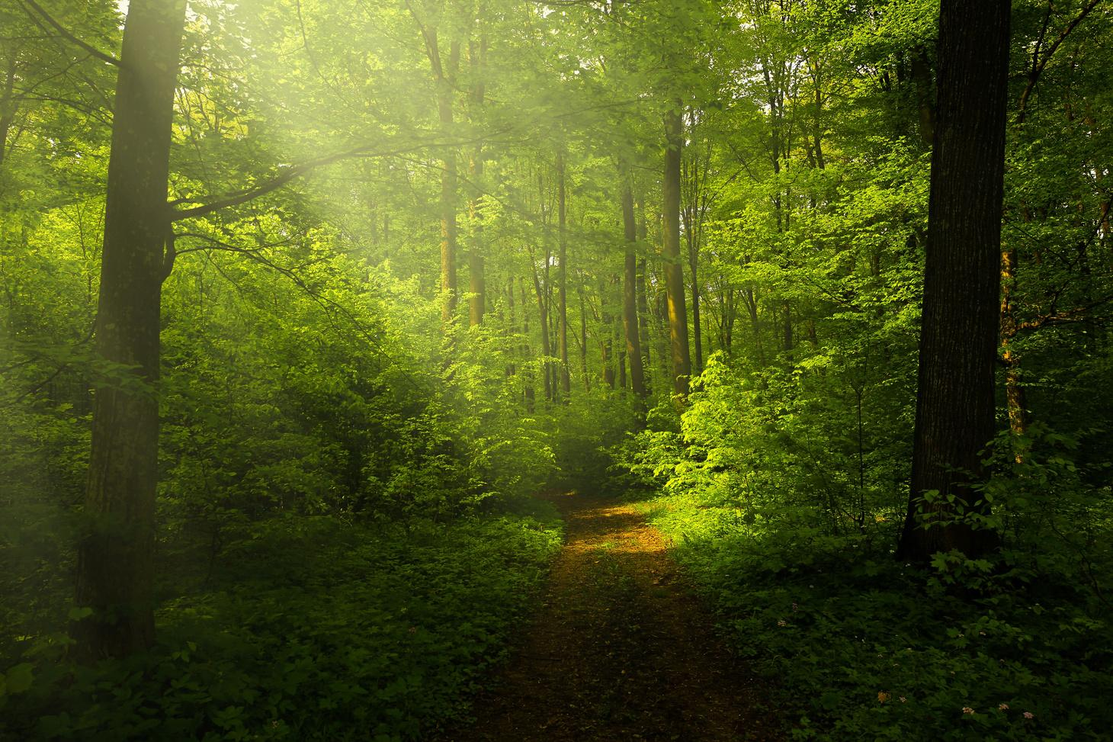
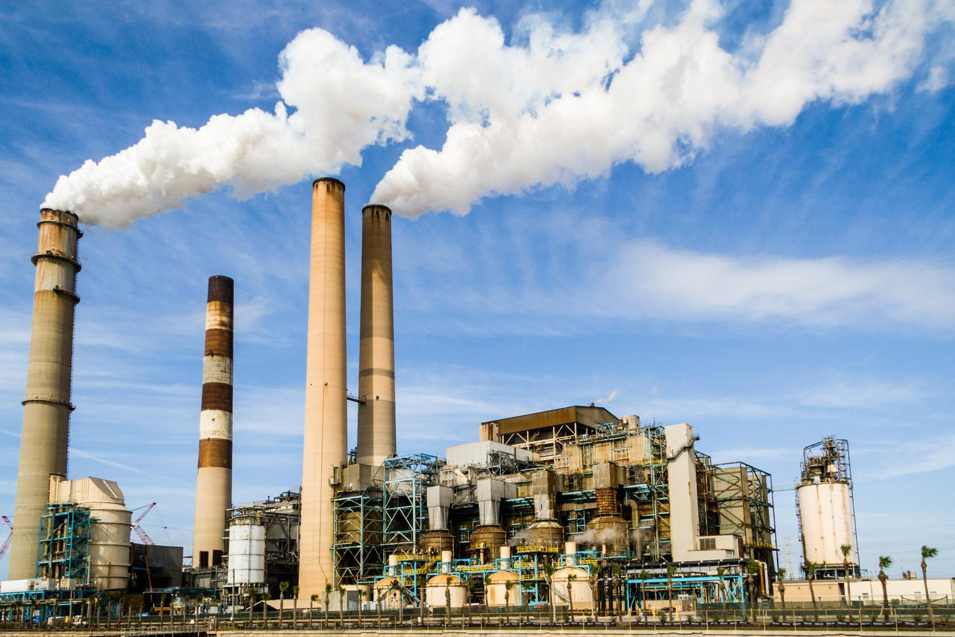
CORONA PANDEMIC OBSERVATIONS
CERTAIN INDUSTRIAL-EMISSIONS CONTRIBUTE TO
O₃ - FORMATION
Written on June 9, 2021, NASA found -
"Local lockdowns brought fast global ozone reductions
Emissions of nitrogen oxides (NOx) – which create ozone, a danger to human health and climate – decreased 15% globally, with local reductions as high as 50%
As a result of the lower NOx emissions, by June 2020, global ozone levels had dropped to a level that policymakers thought would take at least 15 years to reach by conventional means, such as regulations.

Slide 17


INTERNATIONAL PROTOCOLS
INTERNATIONAL PROTOCOLS ADOPTED FOR OZONE PROTECTION
  The Vienna Convention - 1985
  The Montreal Protocol - 1987
Amendments to the Montreal Protocols:
  The London Amendment - 1990
  The Copenhagen Amendment - 1992
  The Montreal Amendment - 1997
  The Beijing Amendment - 1999
  The Kigali Amendment - 2016
LEARN MORE

Slide 18
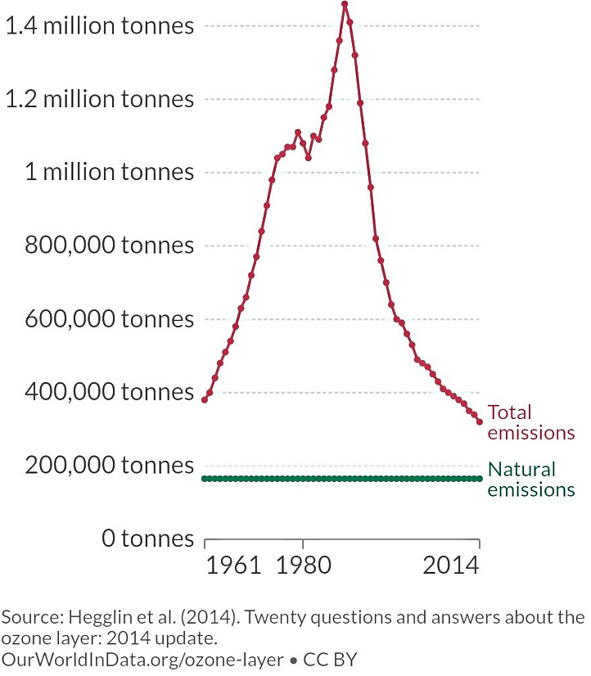
EMISSIONS : RISE & FALL
In the chart besides,
emissions of Ozone-depleting substances are seen from 1960 onwards, measured in tons of CFC-11 equivalents.
CFC-11 is a standardized measure to normalize the sum of a range of ozone-depleting substances, to a value equivalent to their potential to deplete ozone.
Here, a clear growth-peak-reduction is seen with also a rapid rise by 3 folds from 1960s to 1980s.
By 2010, emissions returned to 1960 levels a result of various strict international regulatory agreements

Slide 19

REFERENCES :
  https://en.m.wikipedia.org/wiki/Ozone
  https://www.nasa.gov/feature/ipl/local-lockdowns-brought-fast-global-ozone-
  https://ww2.arb.ca.gov/resoucesozone-and-health
  https://www.e-education.psu.edu/rocco/node/2034
  https://ourworldindata.org/grapher/ozone-depleting-substance-emissions

Slide 20


THANK YOU

